Slide 1

A Parallel Algorithm for Constructing Multiple Independent Spanning Trees in Bubble‑Sort Networks
GROUP MEMBERS :
SAAD AWAIS 22I-1303
NOUMAN NAWAZ 22I-0752
MUZZAMIL HISSAN 22I-0881

Slide 2

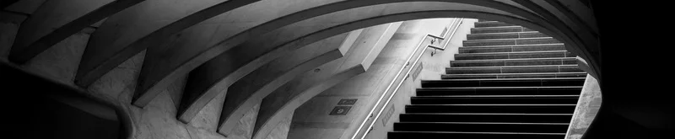
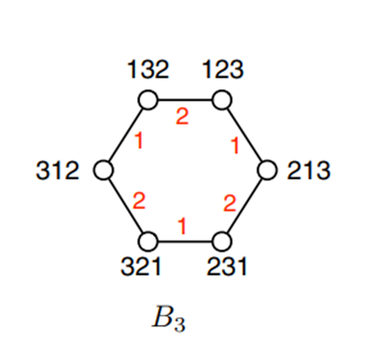

Background
  Reliable broadcast ⇒ need disjoint paths ⟶ fault‑tolerance
  Secure distribution ⇒ split packets over multiple trees
  Independent spanning trees (ISTs) provide both guarantees
  Bubble‑sort networks (Cayley graphs on permutations) as target topology ​
ELASTIC SEARCH

Slide 3
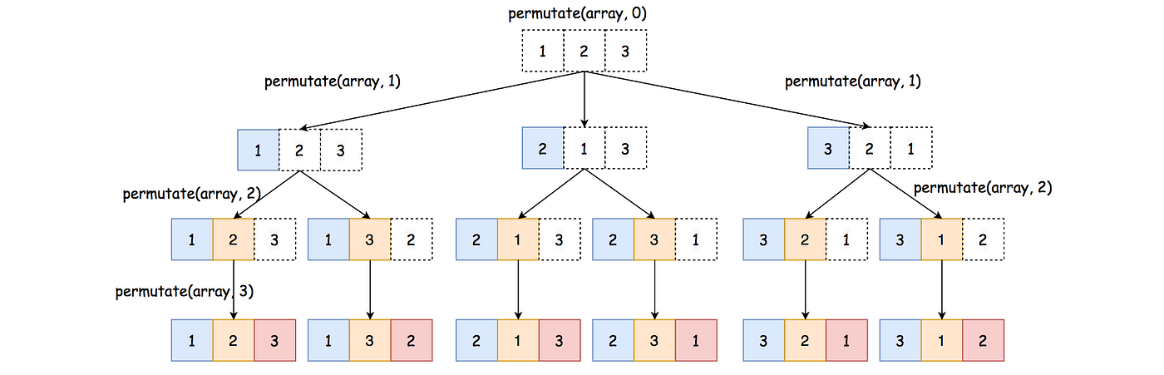
Preliminaries
  Σₙ = set of all permutations of {1…n}
  Adjacent‐swap: p〈i〉 swaps positions i & i+1
  Bₙ = graph on Σₙ with edges p–p〈i〉 for i=1…n–1
  Connectivity = n–1, diameter D(Bₙ)=n(n–1)/2

Slide 4
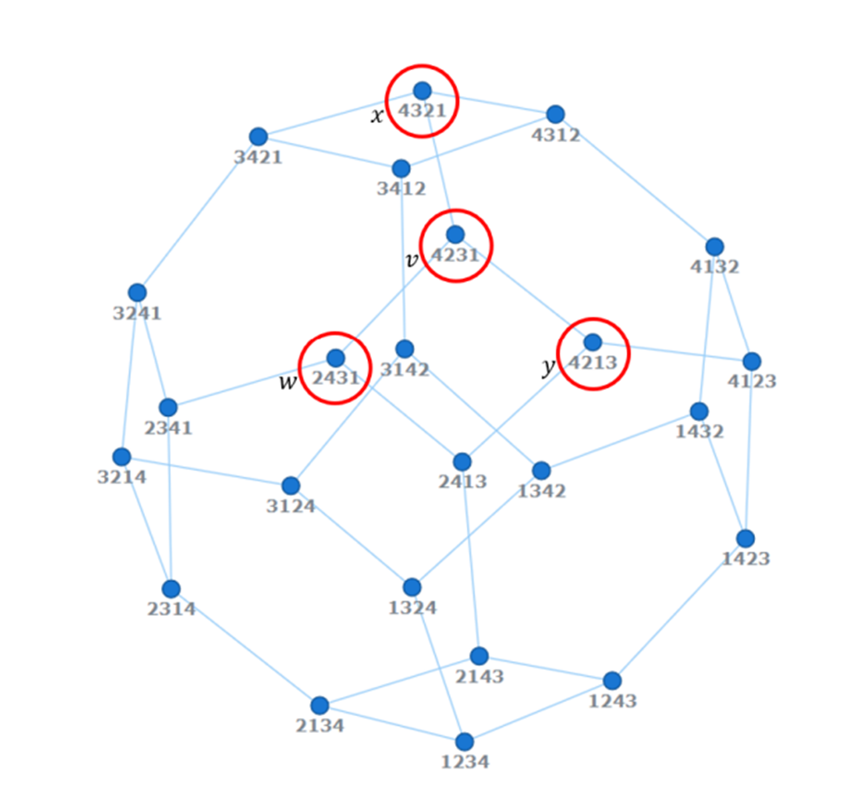
Bubble‑Sort Network
  Vertices = 24 permutations of {1,2,3,4}
  Degree = 3 (swap positions 1–2, 2–3, or 3–4)
  Highly symmetric, regular, vertex‑transitive

Slide 5

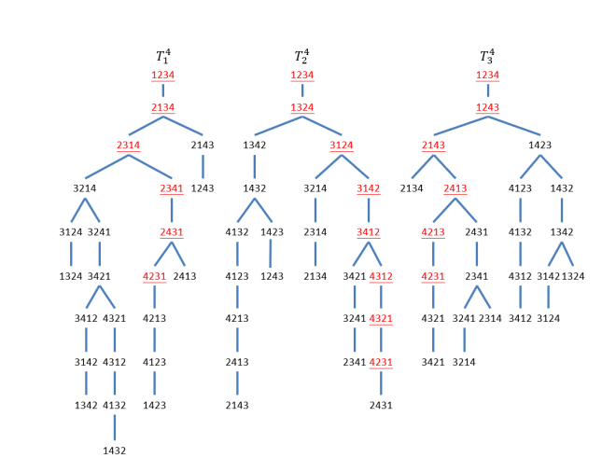
INDEPENDENT SPANNING TREES (ISTS)
  A spanning tree T: connects all nodes, no cycles
  Two trees T¹, T² are independent if for any v≠r, paths v→r in T¹/T² share only v & r.
  In a k‑connected graph up to k ISTs exist
​
  Goal: build n–1 ISTs in B

Slide 6

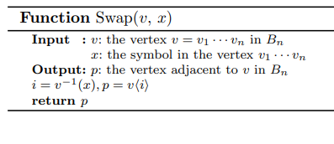


Function Swap(v, x)
  Purpose: move symbol x one step toward the “right” in permutation v
  Input: v=p₁…pₙ, symbol x
  Steps:
  Find i = p⁻¹(x) (precomputed inverse)
  Return v〈i〉 (swap positions i & i+1)
  Example: v= 4231, x=3 ➔ positions: p⁻¹(3)=4 ➔ swap p₄&p₅ ⇒ 4213

Slide 7
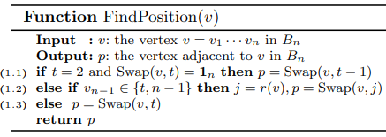
FUNCTION FINDPOSITION(V, T)
  Handles special “last‐symbol = n” cases
  If t=2 & Swap(v,2)=1ₙ Swap(v,1)Steps:
  Else if pₙ₋₁ ∈ {t, n–1} ⇒ j=r(v) (rightmost misplace) ⇒ Swap(v,j)
  Else ⇒ Swap(v,t)
  Example: v= 5 4 3 2 1 (n=5), t=3 ⇒ p₄=2∉{3,4} ⇒ Swap(v,3)

Slide 8
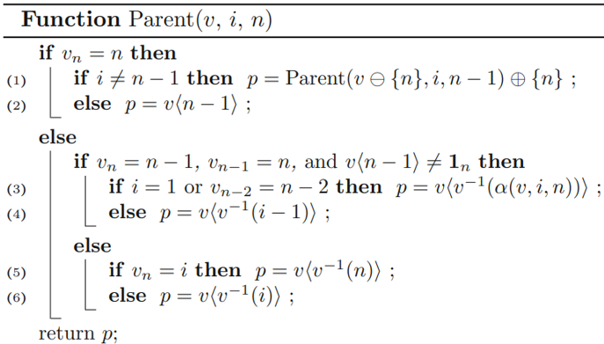
Main Routine Parent1(v, t, n)
  Inputs: v (≠1ₙ), tree‐index t∈[1,n–1], dimension n
  Case A: pₙ=n
  If t≠n–1 ⇒ parent=FindPosition(v)
  Else ⇒ parent=Swap(v, pₙ₋₁)
  Case B: pₙ=n–1 & pₙ₋₁=n & Swap(v,n)≠1ₙ
  If t=1 ⇒ Swap(v,n) else Swap(v,t–1)
  Case C: otherwise
  If pₙ=t ⇒ Swap(v,n) else Swap(v,t)
  Example: v= 4231, t=1,n=4 ⇒ p₄=1≠4,3 ⇒ Swap(v,1)= 2431

Slide 9

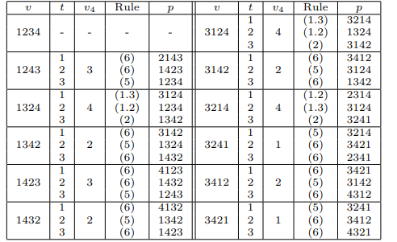
Output Table
Columns: vertex v, tree t, last symbol p₄, rule used, resulting parent p
Exhaustively lists all 24–1=23 v’s for t=1,2,3 ​
Highlights: each v maps to exactly one parent per t, following appropriate rule
Specific example: v=3214, t=3 ⇒ p₄=4, rule (2) ⇒ Swap(v,3)=3241

Slide 10

Recursive Approach
Issues
  PRIOR ALGORITHM: RECURSIVELY SWAP SYMBOLS UNTIL ROOT REACHED ​
  PROBLEMS:
  DEEP CALL‐STACK PER VERTEX
  SEQUENTIAL: CAN’T COMPUTE PARENT FOR TREE T UNTIL LOWER‐LEVEL CALLS FINISH
  HARD TO DISTRIBUTE WORK ACROSS PROCESSORS

Slide 11


Sequential Implementation
Pre‑process each v in O(n)
Step 1
Follow Parent1 sequentially along path: up to O(n²) swaps per tree
Step 2
Build each of n–1 trees one after another
Step 3
Back to Agenda

Slide 12
COMPLEXITY ANALYSIS
Amortized O(1) per parent lookup, but sequential path length ≈D(Bₙ)=O(n²)
O(n²·n!) across all t due to sequential steps
Eliminate path dependency → achieve per‐vertex O(1) for all t
O(n²·n!) across all t due to sequential steps
RECURSIVE METHOD
TOTAL WORK
PARALLEL GOAL
Back to Agenda

Slide 13
Parallelization with MPI
01
02
03
GRAPH PARTITION
MPI RANKS
LOCAL PARENT1
use METIS to split Σₙ into roughly equal chunks
  Each rank processes its subset of vertices v in parallel
  Every rank computes parent pointers for all t in O(1) per v
Back to Agenda

Slide 14
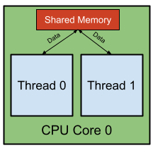
INTRA‑NODE PARALLELISM (OPENMP)
OpenMP
  OpenMP threads: within each MPI process, spawn threads over v’s subset
  Shared read‑only p⁻¹ and r(v) arrays → thread‑safe
  Result: full utilization of cores on each node

Slide 15

COMPLEXITY ANALYSIS OF PARALLELIZATION
  Work per rank: O((n·n!)/P) total parent‐lookups across all trees
  Communication: one initial scatter of p⁻¹/r(v) arrays, negligible thereafter
  Latency: O(1) per lookup, no further synchronization
  Total work: O(n·n!) divided across P×T workers → O((n·n!)/(P·T)) per worker
  Scalability: near‑linear up to P·T ≲ n!/(some constant)
  Overall cost: O(n·n! + communication_overhead + thread_overhead) ≈ O(n·n!)/(P·T)
HYBRID MPI
+
OPENMP
MPI‑ONLY

Slide 16

ANY QUESTIONS?

